Slide 1

Welcome to the
University of Reading
Meteorology Day 2014
“How do we predict the weather?”
Notes:
Introduce staff and student ambassadors
Fire alarm
Toilets

Slide 2
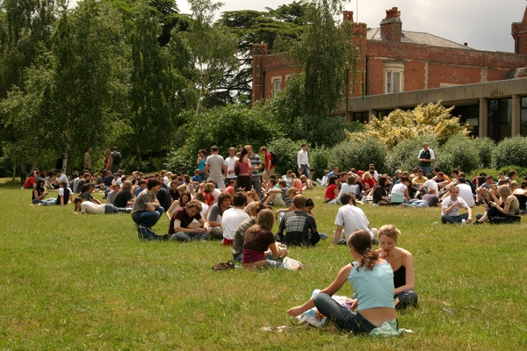
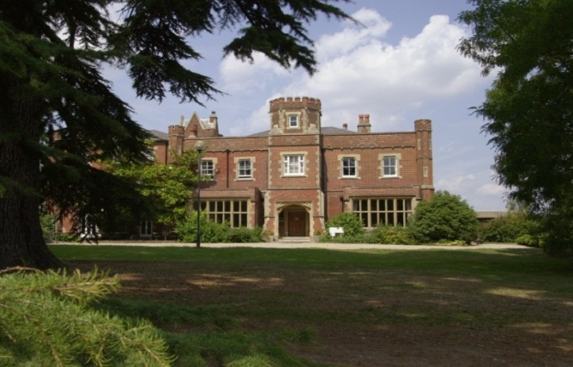
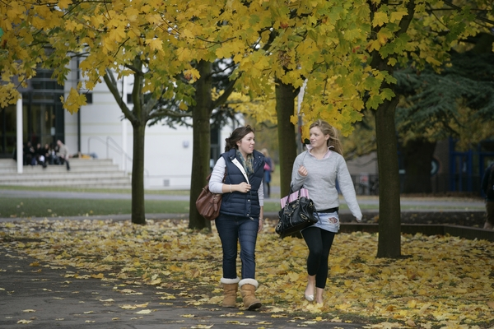
Established in 1892, Received Royal Charter in 1926.
Around 19,000 full and part-time students
20% International Students from over 150 countries.
Over 4,000 staff across all departments
Approx 250 different subjects and combinations of subjects ranging from Sciences, Arts, Humanities, Social Sciences
Science subjects are very popular and include biological sciences, chemistry, food science, microbiology, electronic engineering, meteorology, cybernetics
Masters and PhD programmes are available
Notes:
Introduce staff and student ambassadors
Fire alarm
Toilets

Slide 3


Emergencies
On hearing the fire alarm make your way to the nearest available safe exit route and leave the building without delay.
The fire assembly point is located at the far side of the car park in front of the Department.
Notes:
Once you have left the building make your way to the fire assembly point which is located at the far side of the car park in front of the Department. Do not re-enter the building. Wait at the assembly point until you are informed by the Evacuation Officer or University Security that it is safe to return to the building.

Slide 4

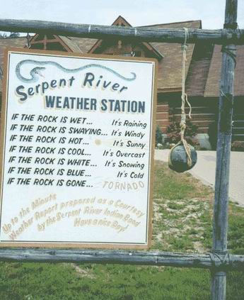
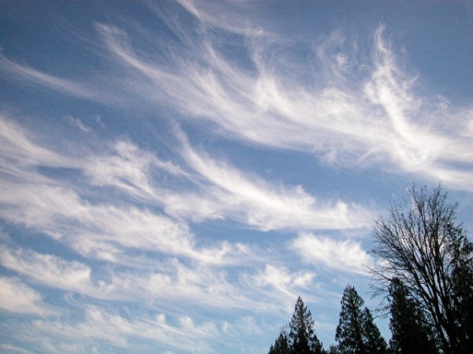
How do we predict the weather and climate?
?
Notes:
The difference between weather and climate is a measure of time. Weather is what conditions of the atmosphere are over a short period of time, and climate is how the atmosphere "behaves" over relatively long periods of time.
Does anyone know how we predict the weather and climate?

Slide 5
How do we predict the weather and climate?
What is a prediction?
What is the difference between weather and climate?
Notes:
The difference between weather and climate is a measure of time. Weather is what conditions of the atmosphere are over a short period of time, and climate is how the atmosphere "behaves" over relatively long periods of time.
Does anyone know how we predict the weather and climate?

Slide 6
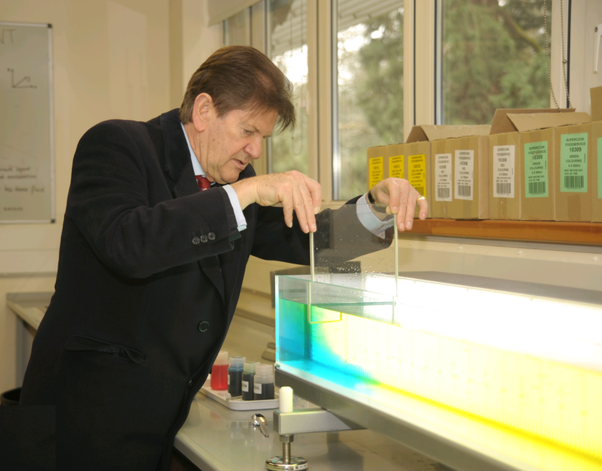
Step 1: Find out how the atmosphere works
Fluids Experiment
Notes:
The atmosphere is a fluid (just like water!)
We can do experiments with water (easier to move around than air) to find out how air moves around.
We can use the results of the experiments to find physical laws which we can use to make predictions

Slide 7
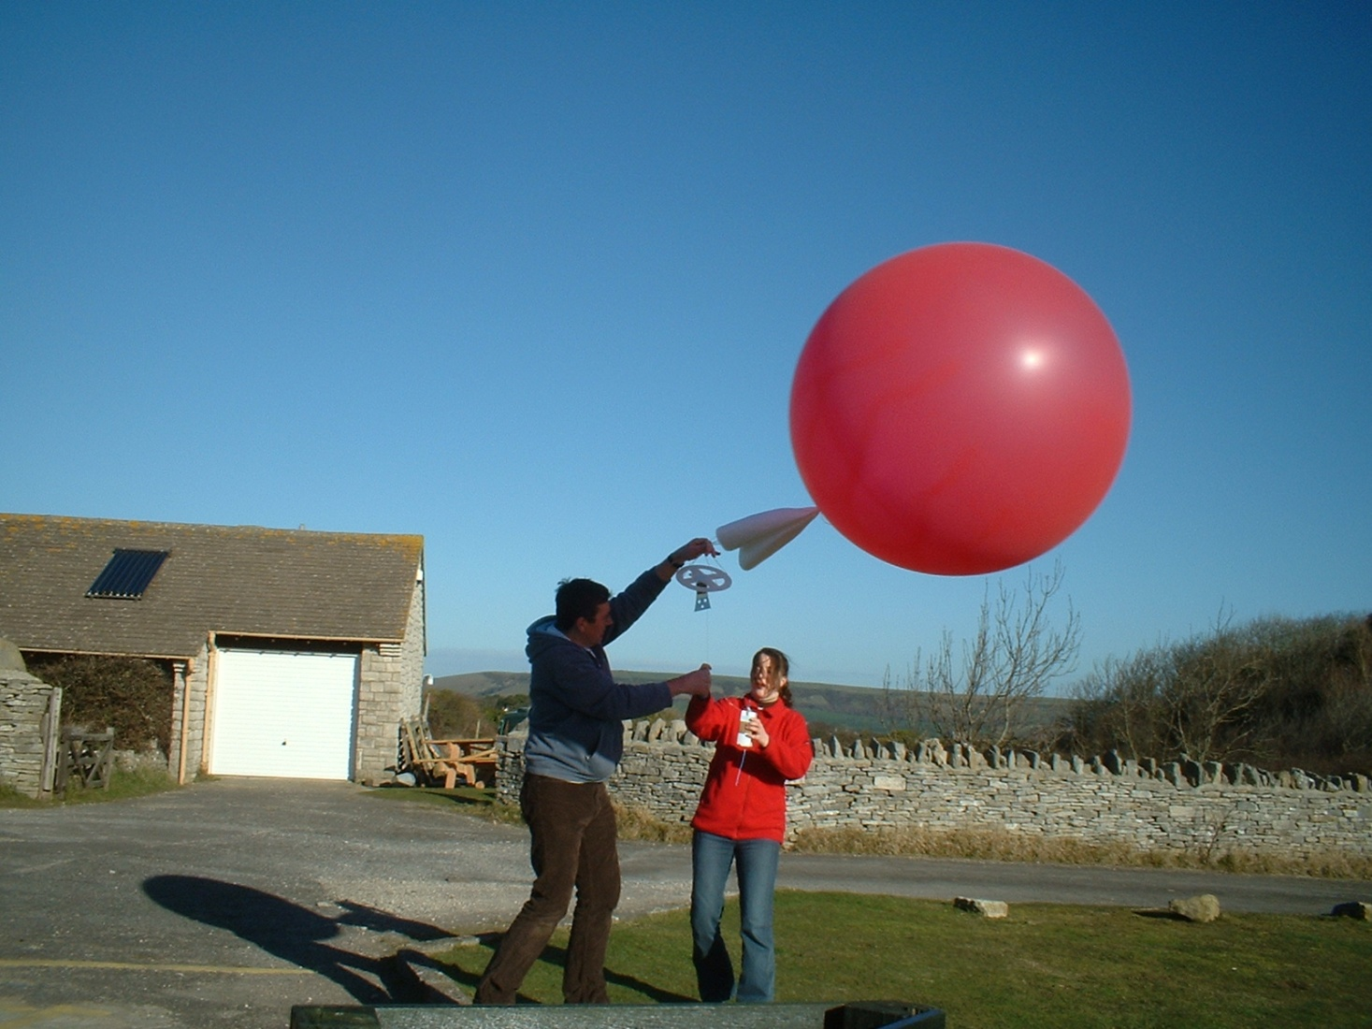
Step 2: Make some observations of the atmosphere
Notes:
If we can find out what the temperatures and winds in the atmosphere are like today it will help us make predictions.
We need to observe the atmosphere at different heights and in different locations.
Observations of the weather are made 24 hours a day, all over the world. The main observations are from weather satellites, balloons, land based instruments, ships, buoys and aircraft.
Each day, the MetOffice uses around half a million observations of temperature, pressure, wind speed and direction, humidity and many other properties to provide the starting conditions of our weather forecast model. We continually update our knowledge of the current state of the

Slide 8
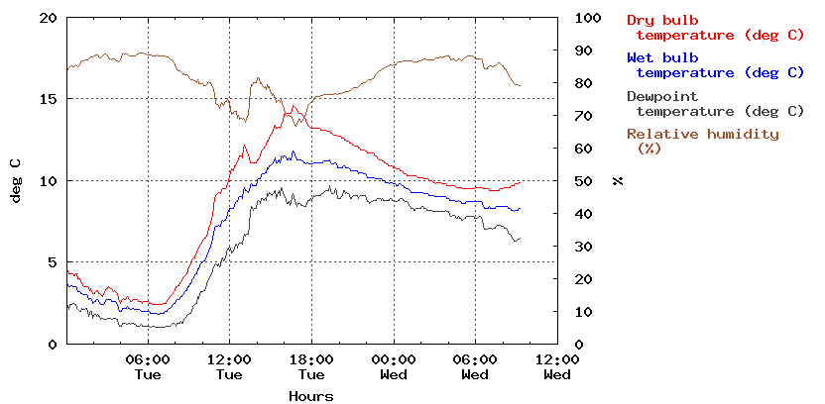
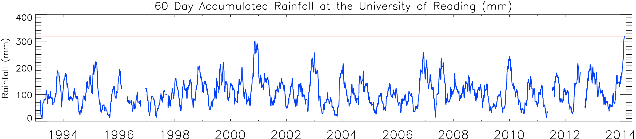
Observations of the atmosphere

Slide 9
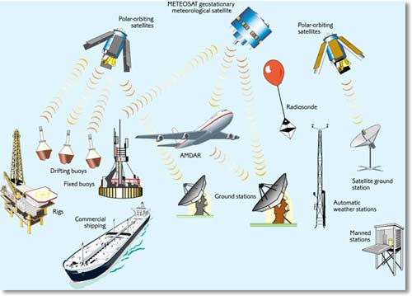
Observations of the atmosphere

Slide 10
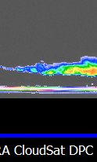
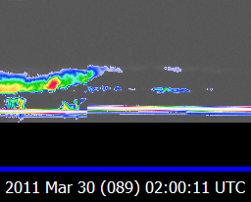
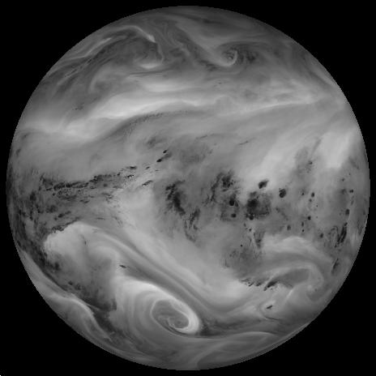
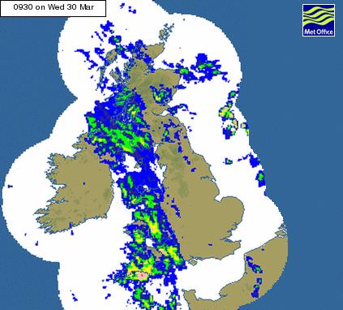
Remote Sensing

Slide 11

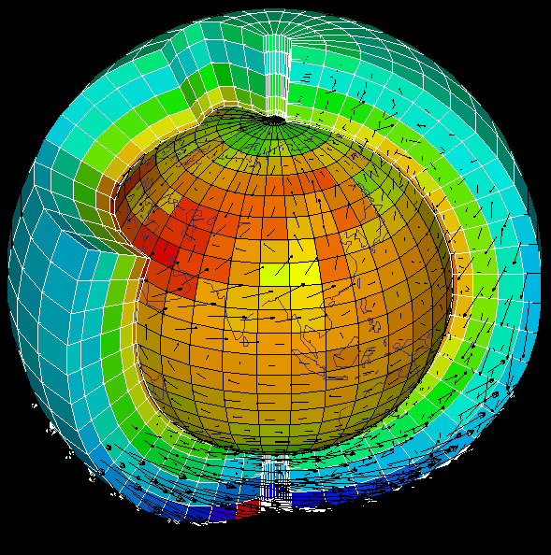
Step 3: Make some predictions
Notes:
If we know what the atmosphere looks like now (observations) and we know how it normally behaves (physical laws) we can make predictions
To do this we need to make lots of calculations which show how the atmosphere will change over time
Our numerical model starts with the current atmospheric conditions in the area of interest from the surface to the upper atmosphere at points on a three dimensional grid.
The atmosphere is a thin shell of turbulent gas on a rotating Earth. Numerical Weather Prediction (NWP) models replicate the behaviour of this gas with mathematical equations.
Details of the wind speed and direction, temperature, pressure, moisture and cloud in each grid box are then stored in a computer.

Slide 12
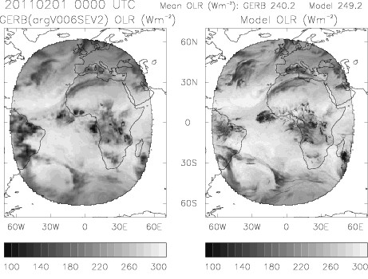
Verify and Improve Simulation

Slide 13
Timetable
Computation: Richardson Forecast Factory - in this room
Experiment: Fluid lab (downstairs)
Observations: Outside (straight out the window)
Lunch and Weather Forecast - in this room
Radiosonde balloon launch (Field Site, 10:30am)

Slide 15

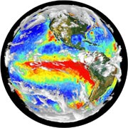

Sunshine and Showers:
How do we predict the weather?
Wednesday 22nd May 2013

Slide 16
University of Reading
General Profile
Established in 1892, Received Royal Charter in 1926.
Around 19,000 full and part-time students
20% International Students from over 150 countries.
Over 4,000 staff across all departments
Approx 250 different subjects and combinations of subjects ranging from Sciences, Arts, Humanities, Social Sciences
Science subjects are very popular and include biological sciences, chemistry, food science, microbiology, electronic engineering, meteorology, cybernetics
Masters and PhD programmes are available

Slide 17
FAQ
Weather forecasts aren’t always accurate a few days ahead, so how can you possibly predict the climate over the next 100 years?
Notes:
Weather forecasts aren’t always accurate a few days ahead, so how can you possibly predict what climate over the next 100 years?
Although they are made by the same sort of mathematical model, weather forecasts and climate predictions are really quite different. A weather forecast tells us what the weather (for example, temperature or rainfall) is going to be at a certain place and time over the next few days.
A climate prediction tells us about changes in the average climate, its variability and extremes. So, it might say that Berkshire, in 40–60 years time, will have, on average 25% more rain in winter with three times the current number of heavy rainfall events. It not forecast that it will be raining in Berkshire on the morning of 15 October 2044.

